Slide 1
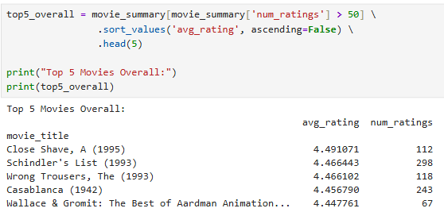
Hope Artificial Intelligence
Popularity based Recommendation System
Top 5 Movies

Slide 2
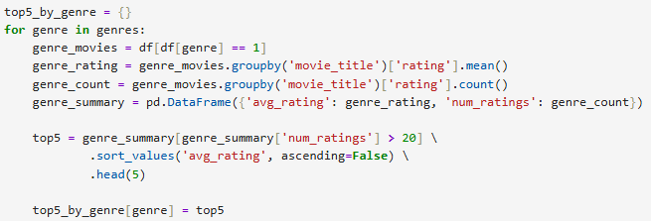
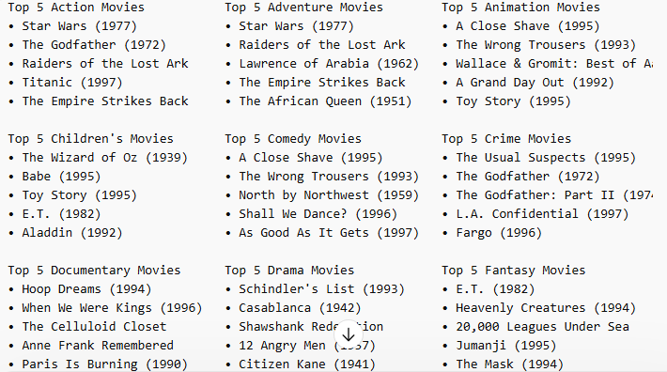
Top 5 movies, by Genre:

Slide 3
